Slide 1
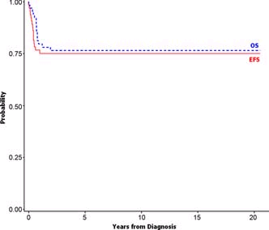
AIEOP-8805 protocol (n=65)
Pillon M, et al. Pediatr Blood Cancer. 2011;56:544-50

Slide 2
Resultados en adultos
Notes:
2

Slide 3
PETHEMA LAL3/97

Slide 4
Patients and therapy
Patients 59 (1997-2003)
HIV- 40
HIV+ 19
HAART 10* (responders 7**)
No HAART 9
Therapy
Pre-phase CPM, PDN
Cycle A IPM, VCR, DXM, HDMTX, ARA-C, VM26
Cycle B VCR, HDMTX, CPM, DXM, ADR
CNS proph. MTX, ARA-C, DXM in each cycle
3 cycles A alternating with 3 cycles B every 21 days
*5 were taking HAART at diagnosis and 5 began HAART at BL diagnosis
** HIV viral load <50 copies/mL and ≥30% rise in CD4 lymphocyte count
with respect to pre-therapy values (all cases ≥200x10⁶/L)

Slide 5
HIV- vs. HIV+ Response to therapy
HIV- (n=40) HIV+ (n=19) p
CR , % 31(77%) 13(68%) NS HAART resp. (n=7) - 6(86%)
HAART no/NR. (n=11) - 7(64%)
3-yr. DFS (%) 50±22 71±20 NS
HAART (n=6) - 83±29
No HAART (n=5) - 60±32
HAART resp. (n=5) - NA
HAART no/NR (n=5) - 60±39
3-yr. OS (%) 53±15 46±20 NS
HAART (n=10) - 60±27
No HAART (n=9) - 33±29
HAART resp. (n=7) - 85±24 0.04
HAART no/NR (n=11) - 27±22
Median follow-up: 33 mo (range 9-70).

Slide 6
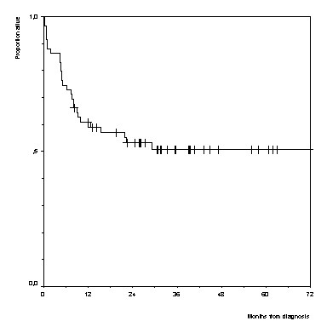
Resultados en adultos. PETHEMA LAL3-97.
Supervivencia global
51±10%, n= 59
A Oriol, JM Ribera, et al. Haematologica 2003; 88: 445-453

Slide 7
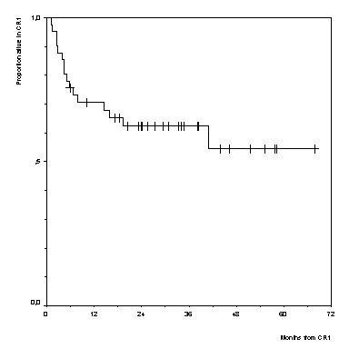
Resultados en adultos. PETHEMA LAL3-97.
Supervivencia libre de enfermedad
56±17%, n=41
A Oriol, JM Ribera, et al. Haematologica 2003; 88: 445-453

Slide 8
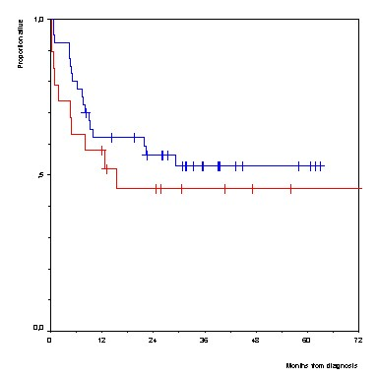
Infección por VIH y pronóstico
HIV-, 53±15%, n=40
HIV+, 46±20%, n=19
A Oriol et al. Haematologica 2003; 88: 445-453

Slide 9
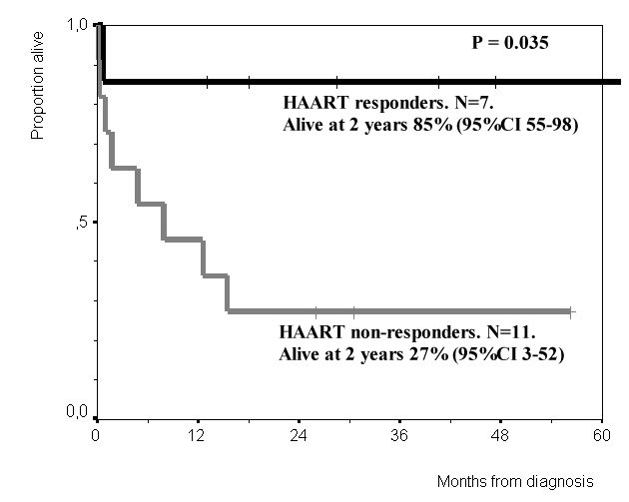
Infección por VIH y pronóstico
A Oriol, JM Ribera et al. Haematologica 2005; 90: 990-2

Slide 10
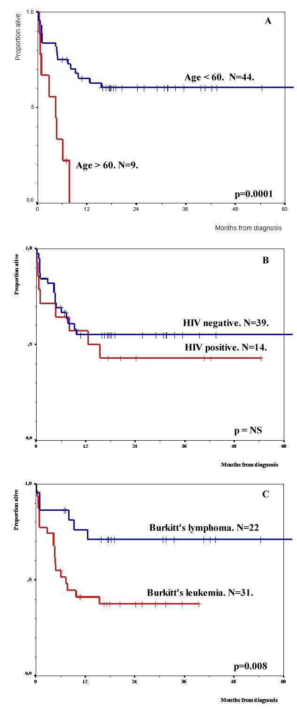
Leucemia/linfoma de Burkitt. Factores pronósticos
Edad
Leucemia
de Burkitt

Slide 11
Leucemia/linfoma de Burkitt
Clínica
Diagnóstico
Morfologia
Citofluorometria/inmunohistoquímica
Citogenética convencional/FISH
Genética molecular
Diagnóstico diferencial
Tratamiento
Quimioterapia específica
Inmunoquimioterapia específica
Nuevos agentes

Slide 12
Inmunoquimioterapia específica
Fundamento
Las células de la leucemia/linfoma de Burkitt expresan fuertemente el CD20
Pautas
R-HyperCVAD
R-CODOX-M/IVAC
B-ALL/NHL2002
BURKIMAB

Slide 13
European Group for Adult ALL European LeukemiaNet
España: BURKIMAB
EudraCT: 2005001-067-64

Slide 14
Adult (> 15yr.) with suspicion of BLL
Staging
Prephase (d1 to 5)
BLL unconfirmed➔ Alternative protocol
Burkitt’s leukemia or lymphoma confirmed
Biologic age < 55 yr.
Full protocol
Biologic age > 55 yr.
Reduced-dose protocol
Cycle A1 (d 7 to 27)
Cycle A1* (d 7 to 27)
Cycle B1 (d 28 to 48)
Cycle B1* (d 28 to 48)
Response evaluation
Progression
Cycle C1 (d 49 to 76)
Cycle A2* (d 49 to 76)
PBPC mobilisation
Cycle A2 (d 77 to 97)
Cycle B2* (d 77 to 97)
Cycle B2 (d 98 to 118)
Cycle A3* (d 98 to 118)
Cycle C2 (d 119 to 146)
Cycle B3* (d 119 to 146)
Restaging
Complete remission
Progression / Partial remission
End therapy (stages I-II non-bulky)
Off protocol
Rituximab x2 ( wk 21 and 24)
Notes:
14

Slide 15
Therapeutic schedule
Cycle
Day Drug Dose Administration
Prephase
1-5 Cyclophosphamide 200 mg/m² iv over 1 h.
1-5 Prednisone 60 mg/m² iv bolus.
Cycle A.
7 Rituximab 375 mg/m² iv (4 h).
8 Vincristine 2 mg iv bolus. Day 1.
8 Methotrexate 1500 mg/m² iv over 24 h^{a,b} .
8-12 Iphosphamide 800 mg/m² iv over 1 h.
8-12 Dexamethasone 10 mg/ m² iv bolus.
11-12 Teniposide (VM26) 100 mg/m² iv over 1 h.
11-12 Cytarabine 150 mg/m² iv over 1 h every 12h
Cycle B.
28 Rituximab 375 mg/m² iv (4 h)
29 Vincristine 2 mg iv bolus. Day 1.
29 Methotrexate 1500 mg/m² iv over 24 h^{a,b}
29-33 Cyclophosphamide 200 mg/m² iv over 1 h.
29-33 Dexamethasone 10 mg/ m² iv bolus.
32-33 Doxorubicin 25 mg/m² iv over 15 min.
Notes:
15

Slide 16
Therapeutic schedule (cont’d.)
Cycle
Day Drug Dose Administration
Cycle C.
49 Rituximab 375 mg/m² iv (4 h)
50 Vindesine 3 mg/m² (max. 5 mg) iv bolus. Day 1.
50 Methotrexate 1500 mg/m² iv over 24 hª
50-54 Dexamethasone 10 mg/ m² iv bolus.
53-54 Etoposide 250 mg/m² iv over 1 h.
54 Cytarabine 2000 mg/m² iv over 3 h/12 h^{b}.
Central nervous system prophylaxis.
1-8-12-29-33 Methotrexate 15 mg intrathecal. Cytarabine 40 mg Dexamethasone 20 mg
- Cycles A to C are repeated from days 77 to 124 to complete 6 treatment cycles
after the prephase and 8 intrathecal doses for CNS prophylaxis.
- After completion of treatment cycles, two additional doses of rituximab were given
(week 21 and 24 at standard dose) making a total of 8 doses of rituximab.
ª Folinic acid rescue from 12 h of the end of infusion
^{b}Half dose in patients over 55 yr.
- Growth factors allowed from neutrophil count < 0.5x10⁹/L until recovery for each cycle.
Notes:
16

Slide 17
Baseline characteristics
 |  | HIV–positive (n=41 ) | HIV-negative (n=80) | Total (n=121) | p value
Gender, male (%) |  | 34 (83%) | 55 (69%) | 89 (74%) | 0.128
Age, median [min;max] |  | 42 [20 ; 59] | 48 [15 ; 83] | 45 [15; 83] | 0.033
Diagnosis, n (%) | Burkitts Lymphoma | 33 (80%) | 51 (64%) | 84 (69%) | 0.120
 | Burkitt’s leukemia | 4 (10%) | 20 (25%) | 24 (20%)
 | Burkitt-Like Lymphoma | 4 (10%) | 9 (11%) | 13 (11%)
Ann Arbor stage, n (%) | I – II | 6 (15%) | 21 (26%) | 24 (20%) | 0.172
 | III - IV | 35 (85%) | 59 (74%) | 97 (80%)
ECOG ≥2 |  | 22 (54%) | 32/78 (41%) | 54/119 (45%) | 0.245
Extranodal involvement (≥2 sites), n(%) |  | 19 (46%) | 37 (46%) | 56 (46%) | 0.99
CNS involvement, n(%) |  | 4 (10%) | 10 (13%) | 14 (12%) | 0.77
Bulky disease, n(%) |  | 13 (32%) | 15 (19%) | 28 (23%) | 0.118
Elevated LDH, n(%) |  | 40 (98%) | 68/78 (87%) | 108/119 (91%) | 0.095
Age-adjusted IPI, n (%) | Low | 1 (2%) | 6/77 (8%) | 6/118 (5%) | 0.179
 | Low-Intermediate | 4 (10%) | 12/77 (16%) | 17/118 (14%)
 | Intermediate-High | 15 (37%) | 35/77 (45%) | 48/118 (41%)
 | High | 21 (51%) | 24/77 (31%) | 47/118 (40%)
Years of follow-up, median [min;max] |  | 3.2 (1.7) | 2.4 (1.9) | 2.2 (1.9) | 0.09

Slide 18
Treatment response
Variable | HIV + | No HIV | Total
Evaluable patients | 40* | 73* | 113
Early withdrawal | - | 2 (3%) | 2 (2%)
Death in induction | 5 (13%) | 4 (5%) | 9 (8%)
Resistance | 2 (5%) | 4 (5%) | 6 (5%)
Complete response | 33 (83%) | 63 (86%) | 96 (85%)
Relapse | 2 (5%) | 4 (5%) | 6 (5%)
Death in remission | 5** (13%) | 3** (4%) | 8 (7%)
*The remaining 8 patients were on treatment at the time of the analysis
**All deaths were caused by infection

Slide 19
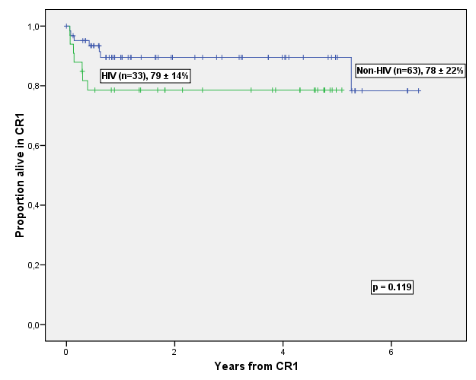
Disease-free Survival (DFS)

Slide 20
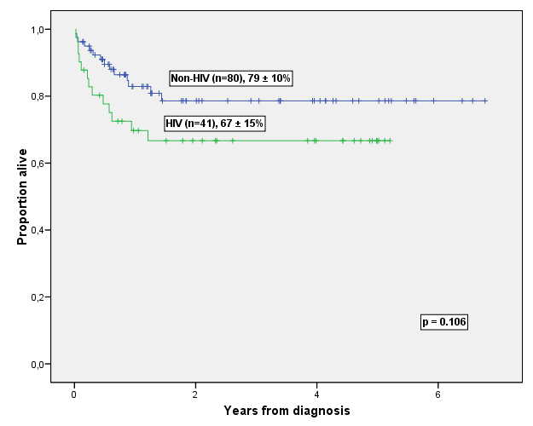
Overall Survival (OS)

Slide 21
Comparison between GMALL and BURKIMAB protocols
 | GMALL B-ALL/NHL2002 * (n=185) |  | BURKIMAB (HIV-negative only, n=80)
 | Burkitt Lymphoma | B-ALL | Burkitt Lymphoma | B-ALL
N | 115 | 70 | 60 | 20
aaIPI>1 | 47% | - | 76% | -
CR | 90% | 83% | 86% | 90%
Death under treatment | 3% | 11% | 5% | 5%
3 yr OS | 91% (<55yr) | 79% (<55yr) | 81% (<55yr) | 82% (<55yr)
 | 84% (≥55yr) | 39% (≥55yr) | 84% (55yr) | 71% (≥55yr)**
** at 1 yr.
*Hoelzer D, et al. 2007 ASH Meeting. Abstract 518

Slide 22
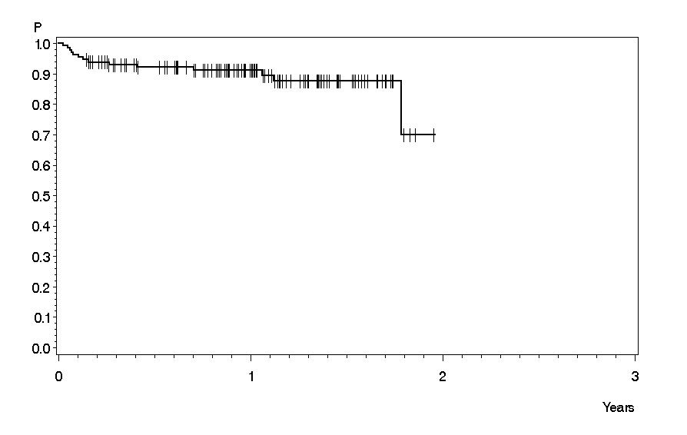
GMALL B-ALL/NHL2002 vs. BURKIMAB
Hoelzer D, et al. 2007 ASH Meeting.
Abstract 518
JM Ribera et al. 2011 EHA Meeting

Slide 23
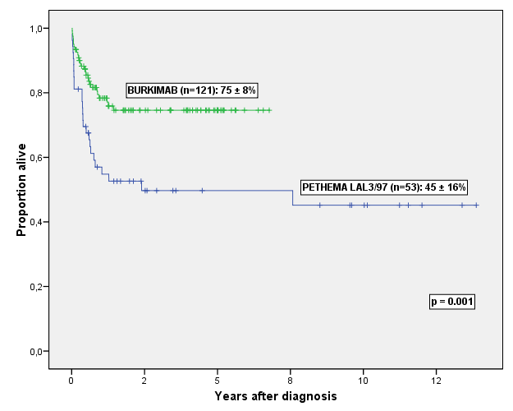
PETHEMA LAL3/97 vs. BURKIMAB

Slide 24
Tratamiento de la leucemia tipo Burkitt resistente o en recaída
Mala respuesta con protocolos equivalentes
Tratamiento de segunda línea basado en cisplatino (ESHAP) o ifosfamida (IFOVM).
Duración de respuesta breve → Si quimiosensibilidad: auto o alo-TPH lo más rápidamente posible.
Supervivencia del 37% si quimiosensibilidad y 7% si quimioresistencia (EBMT).
No evidencia de actividad del injerto contra la leucemia.
Ensayos clínicos

Slide 25
Nuevos tratamientos
Inmuno-quimioterapia
Ofatumomab (anti-CD20).
Anti-CD22.
Terapia dirigida a moléculas
inhibidores de la DNA metiltransferasa (decitabina or 5-azacitidina).
Inhibidores de la histona desacetilasa (vorinostat)
Oligonucleótidos antisentido contra c-myc
Inhibidores del proteasoma
Inhibidores de las cinasas ciclin-dependientes

Slide 26
Mensajes para llevarse a casa
Necesidad diagnóstico completo: morfología + fenotipo + genética
Tratamiento específico
Combinación de quimioterapia específica y anti-CD20 mejora resultados
Tratamiento de soporte, esencial

Slide 27
La leucemia/linfoma de Burkitt puede ser curable en el 80-90% de niños y en el 70-80% adultos

