Slide 1
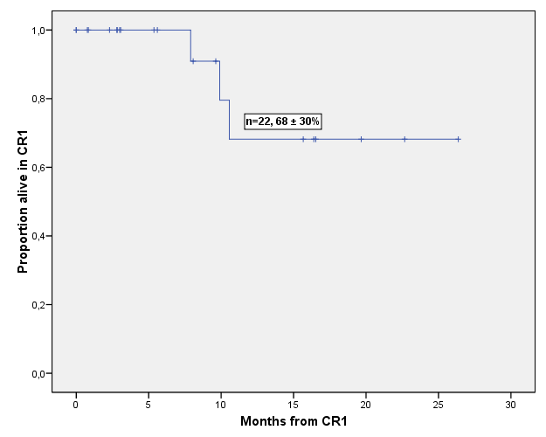
DURACIÓN DE LA RC

Slide 2
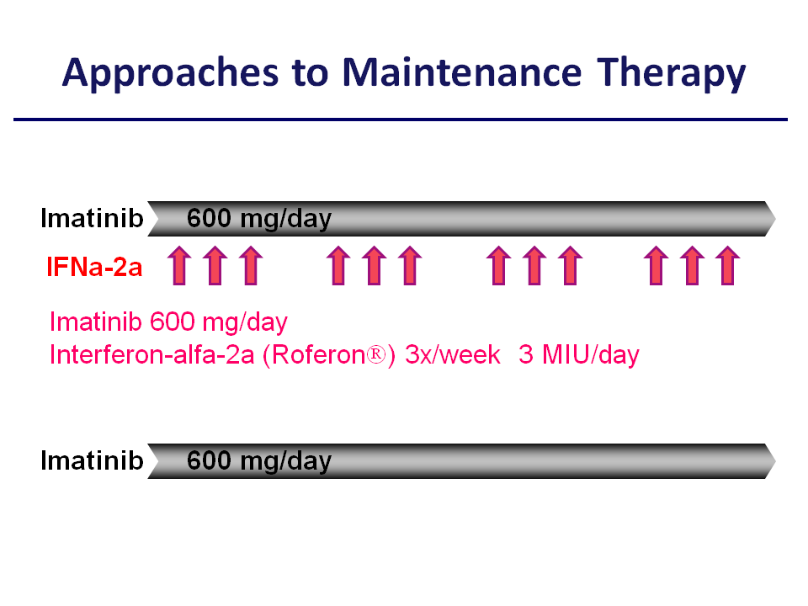

Slide 3
Randomized Study of Pre-emptive versus MRD-Triggered Imatinib after SCT for Ph+ALL
Up-front Imatinib
Imatinib
Re
g
ister
Ph⁺ALL
in CR
SCT
R
4-6 wks
MRD+
Imatinib
MRD-triggered
Imatinib
MRD-monitoring
Courtesy of O Ottmann
Courtesy of O Ottmann

Slide 4
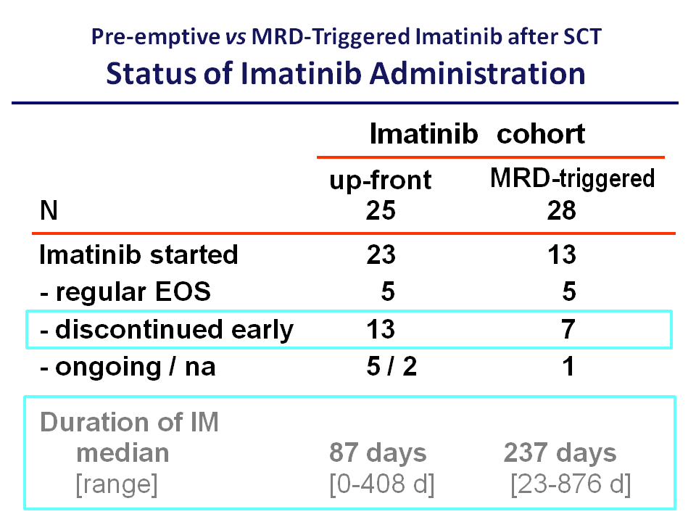

Slide 5
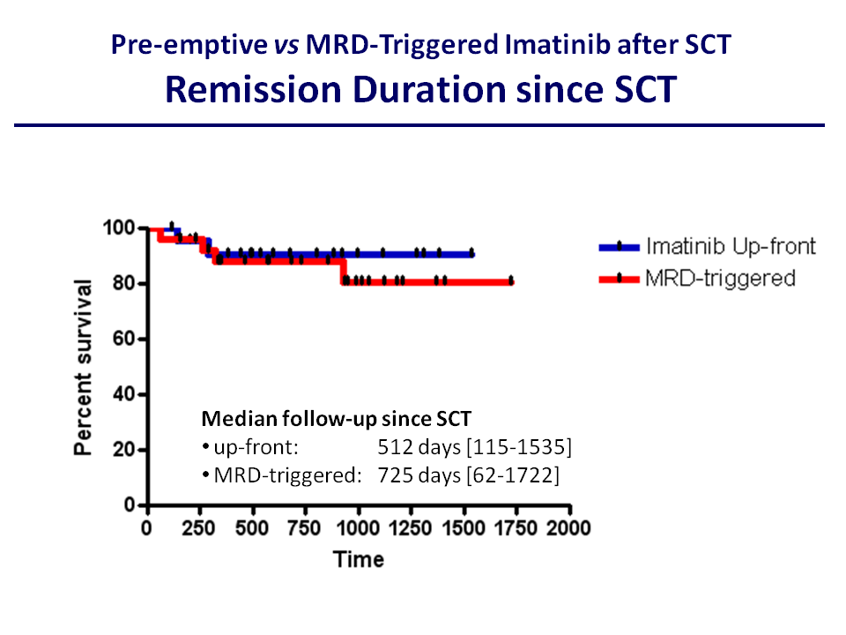

Slide 6
Quimioterapia de moderada intensidad
+
Inhibidores de tirosincinasa de ABL
+
¿? ¿alo-TIR± ITK?
LAL Ph (BCR-ABL) en pacientes edad avanzada

Slide 7
LAL Ph+ edad avanzada
Imatinib o dasatinib +PDN/DXM
Autor | N RC | SLE (%) | SG (%)
Ottmann | 55 96 | - | 42 (2a)
Delannoy | 30 72 | 58 | 76(1a)
Vignetti | 30 100 | 48 | 74(1a)
Foa* | 55 | 100 | ** | 65(20m)
* Dasatinib **14 relapses.

Slide 8
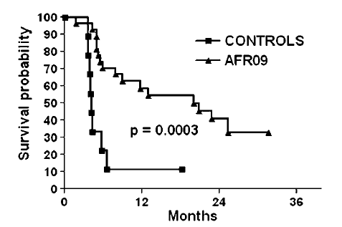
Imatinib-Based Therapy in Elderly Ph(+) ALL:
Comparison of Outcome
GMALL¹
GIMEMA²
GRAALL³
%
EFS
DFS
DFS
AFR09
(+ IM)
hist. control
(no IM)
Days
Months
Months
¹Ottman et al, Cancer 2007;109:2068-76; ² Vignetti et al. Blood. 2007;109(9):3676-8; ³Delannoy et al., Leukemia. 2006; 20:1526-32.

Slide 9
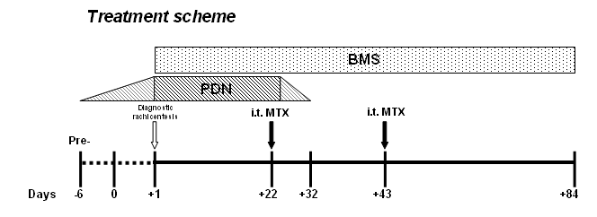
Dasatinib-based therapy in elderly Ph+ ALL.
GIMEMA LAL1205 Protocol
    Dasatinib 70 mg twice a day (total planned treatment is 12 weeks, i.e. 84 days)
    Diagnostic work-up (within 7 d) and monitoring of MRD carried out centrally in Rome
Notes:
9

Slide 10
Overall survival
1.0
0.9
0.8
0.7
0.6
0.5
0.4
0.3
0.2
0.1
0.0
0
5
10
15
20
25
Survival time (months)
Median OS not reached
OS at 14 months: 80.7% (CI 95%)

Slide 11

Dasatinib + non-genotoxic chemotherapy
Elderly Ph+ ALL. EWALL-PH-01 overview
Notes:
11

Slide 12
Efficacy
Courtesy of Ph. Rousselot

Slide 13
Ph+ All >55 yr. LAL OLDPh
Assistential trial

Slide 14
LAL-OPH-07
Registrados 32, 20 centros
Faltan datos : 5
No criterios inclusión : 1
Válidos 26, (81%)
En inducción : 1
Muerte inducción : 3
(2 : infección , 1 : toxicidad)
RC 22, (85%)
RC mol* : 9/22 (41%)
Mantenimiento : 22
Exitus : 1 (toxicidad)
Recaída : 6
En tratamiento: 13
Alo TIR 2
MRT 1
RCC 1
RCC 13
*BCR-ABL/ABL<0,01%
Notes:
14

Slide 15
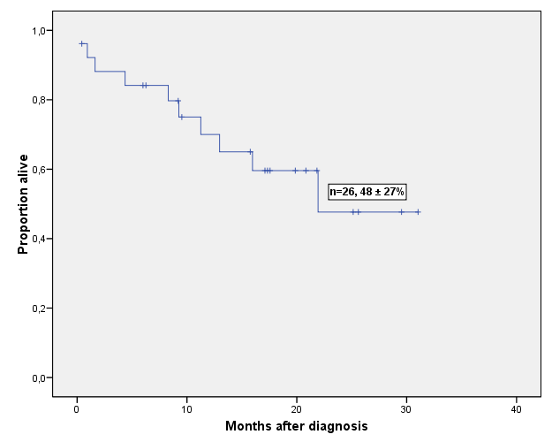
Supervivencia global (n=26)
Mediana de seguimiento: 18 meses
Notes:
15

Slide 16
LAL en pacientes de edad avanzada (>55/>60 a) y BCR-ABL negativo
Tratamiento semiintensivo
+
Nuevos fármacos

Slide 17
Incidence of ALL
children
8
7
6
adolescents
5
adults
4
elderly
3
2
1
0
0-4 5-9 10-14 15-19 20-24 25-29 30-34 35-39 40-44 45-49 50-54 55-59 60-64 65-69 70-74 75-79 80-84 >85 yrs
SEER Program (www.seer.cancer.gov)
Public-Use, Nov 2003 (incidences 1992-2001)

Slide 18
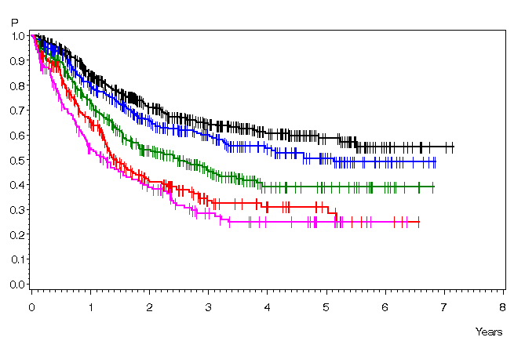
Age is the Strongest Prognostic Factor in ALL
Results of Induction
Overall Survival
Age CR ED
90% 2%
26-35 86% 4%
36-45 84% 6%
46-55 78% 9%
56-65 76% 14%
P<.0001
15-25 y: 0.64 (N=417)
26-35 y: 0.60 (N=322)
36-45 y: 0.46 (N=340)
46-55 y: 0.33 (N=265)
56-65 y: 0.29 (N=170)
P<.0001

Slide 19
Table 1: Intensive chemotherapy and outcome in elderly ALL patients
Outcome in Older Patients with ALL
(pooled published data)
Age N N CR ED OS
(range) Studies Pts (mo/prob.)
Supportive tx 67-91y 1 9 0 n.a. < 1
Palliative Chemo 60-91y 4 94 43% 24% 7
Intensive Chemo 60-92y 15 519 56% 23% 14%
Age specific tx 55-86y 5 187 58% 16% 22%
Best results with age specific moderately intensive chemo
- Lower rate of ED
- Better survival
* weighted mean

Slide 20

Final European Proposal for Standard Chemotherapy of Elderly Patients
with de novo Ph-negative ALL
Cooperative Study by GMALL, GIMEMA, GRAALL, NILG, PETHEMA and PALG
OVERVIEW
Induction and Consolidation Therapy (1st year)
Induction
Cons. I
Cons. II
Cons. III
Cons. IV
Cons. V
Cons. IV
IDMTX
ASP
HDAC
IDMTX
ASP
HDAC
IDMTX
ASP
HDAC
VCR
DEXA
VCR
DEXA
VCR
DEXA
V
Ph I
Ph II
6 MP/MTX
3
5
7
9
14
weeks
10
12
17
19
21
24
26
28
30
32
~ mo 8
34
36
38
41
~ mo 10
1
43
48
~ mo 12
51 52
VCR
DEXA
VCR
DEXA
VCR
DEXA
VCR
DEXA
6 MP/MTX
15
18
21
24
months

Slide 21
LAL-OLD-07
Registrados 28, 19 centros
Faltan datos : 3
No criterios inclusión : 1
Válidos 24, (86%)
Muerte inducción : 3
(1 hemorragia, 2 toxicidad )
Fracaso : 3
RC 18, (75%)
Pendiente inicio consolidación : 1
Consolidación : 17
Exitus : 1 ( toxicidad)
En tratamiento : 3
Abandono: 2 ( toxicidad, SMD secundario)
Recaídas : 6
Mantenimiento : 6
En tratamiento : 2
Recaída : 2
Tratamiento finalizado : 4
RCC 4
Notes:
21

Slide 22
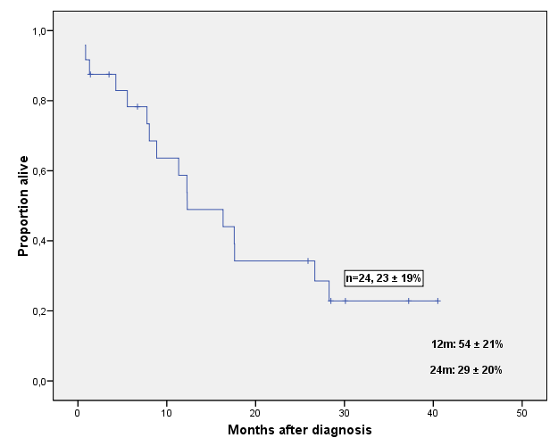
Supervivencia global
Notes:
22

Slide 23
ALL in Older Patients: Summary
Outcomes often poor
Treatment with “palliative” intent may paradoxically produce equally good OS due to very high rates of treatment-related mortality
CR rates and survival in older Ph+ ALL have improved dramatically with tyrosine kinase inhibitors
Clinical trials specifically designed for older individuals are vital
Notes:
ALL, acute lymphoblastic leukemia; OS, overall survival; Ph+, Philadelphia chromosome positive.
Outcomes for older patients with ALL are often poor. Treatment with palliative intent may paradoxically produce equally good overall survival results because of high rates of treatment-related mortality. Rates of complete remission and overall survival in older patients with Philadelphia chromosome–positive ALL have improved dramatically with the advent of tyrosine kinase inhibitors. Clinical trials designed specifically to study treatment of older individuals are vitally important to augment the scant evidence that currently forms the basis for therapeutic recommendations.

Slide 24
LAL Burkitt-like
t(;14), t(2;8), o t(8;22), reordenamiento C-MYC
Quimioterapia específica
+
Rituximab

Slide 25
Nuevos agentes en el tratamiento de la LAL

Slide 26
Dianas moleculares en LLA
Grupo terapéutico Fármaco Tipo LAL
Inhibidores de tirosincinasas I imatinib BCR-ABL, NUP214-ABL1
dasatinib
nilotinib
Otros
Inhibidores de FLT3 Lestaurtinib MLL, hiperdiploidia>50?
Inhibidores farnesiltransferasa Tipifarnib BCR-ABL?, LAL-T?
Lonafarnib
Agentes hipometilantes Azacitidina
Inhibidores histona desacetilasa Vorinostat LAL Burkitt?
Panobinostat
Inhibidores de m-TOR Temsirolimus
Inhibidores del proteasoma Bortezomib
Inhibidores de gamma secretasa MK0752 LAL T

Slide 27
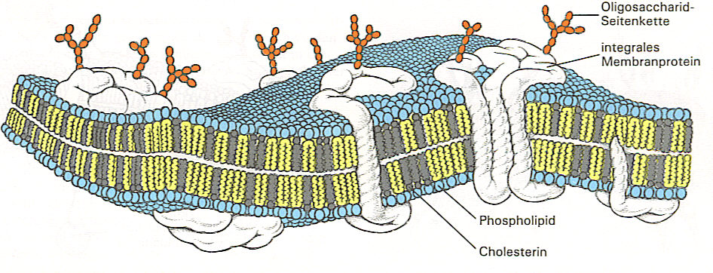
T-ALL. Nucleoside analogs
Fludarabine
Cytarabine
Nelarabine
Cladribine
Clofarabine
Cell death
DNA degradation
dGuo
cell membrane
NAs
NA-MP
NA-TP
inhibition of DNA
synthesis/repair
DNA strand breaks
dCK
inhibition of ribonucleotide reductase
dGuo
dGTP
dNTP imbalance
dGMP
endonuclease
activation
PNP
Forodesine
5-Nucleotidase
apoptosis
Notes:
inhibition of ribonucleotide reductase
activation of poly (ADP-ribose)polymerase
NAD & ATP depletion
energy depletion
Programmed cell death

Slide 28
Bispecific T Cell Engagers (BiTEs) Redirect Any Cytotoxic T Cell to Tumor Cells
Radioimmunoconjugate
(i. e. Zevalin®, Bexxar®)
Complement
T-cell receptor/
CD3 complex
T Cell
ALL-
Cell
NK Cell
BiTE®
ADCC
antigen
CD 19
Monoclonal IgG1
(i.e. Rituxan®)
Immunotoxins
Notes:
Die zytotoische Wirkung von Antikörpern vershieden.

Slide 29
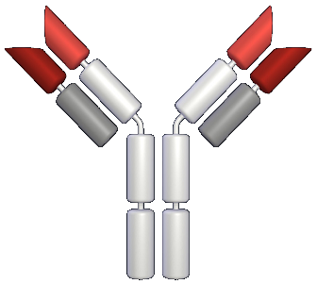


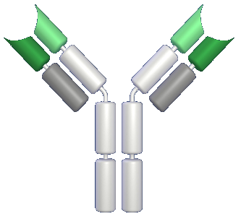
Blinatumomab. Mode of Action
V_{H}
V_{L}
-CD3
Antibody
T Cell
CD3
BiTE®
MT103
Bispecific
Single-chain
Antibody
Target Antigen
Redirected
Lysis
Tumor
Cell
V_{H}
V_{L}
-CD19 Antibody

Slide 30
History of Treatment in Acute Lymphoblastic Leukemia
Cure Rate
(%)
90
Subtype / MRD
Adjusted Tx
>90%
Chemotherapy
80
Single
Combined
High Dose
MTX
70
Targeted Tx
CNS
Prophylaxis
60
Stem Cell
Transplant
50%
50
40
30
20
10
1950
1960
1970
1980
1990
2000

Slide 31
Agradecimientos
Investigadores grupos PETHEMA y GETH
Fundación PETHEMA
GMALL: D Hoelzer, N Göckbuget, O Ottmann
Deutsche José Carreras Leukämie-Stiftung
EWALL Group
Acute Leukemia Working Party EBMT:M Mothy

Slide 32
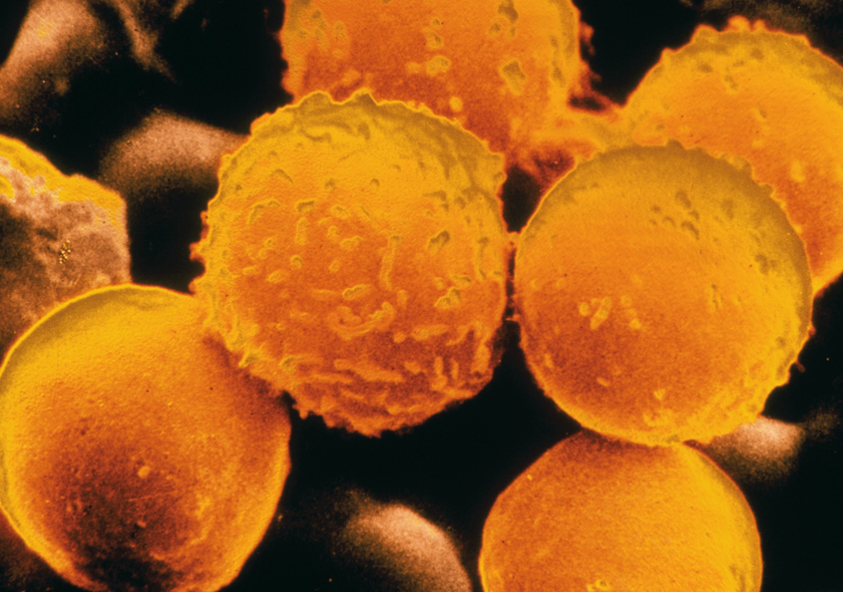
Muchas gracias por su atención
White blood cells from a patient with acute lymphoblastic leukaemia
Lancet Oncology 2009

