Slide 1
Leucemia y linfoma de Burkitt
IV Congreso Paraguayo de Hematologia
y Medicina Transfusional
Asunción, 8 de julio de 2011
JM Ribera
ICO-Hospital Germans Trias i Pujol
Institut de Recerca Contra la Leucemia Josep Carreras
Badalona
Universidad Autónoma de Barcelona

Slide 2
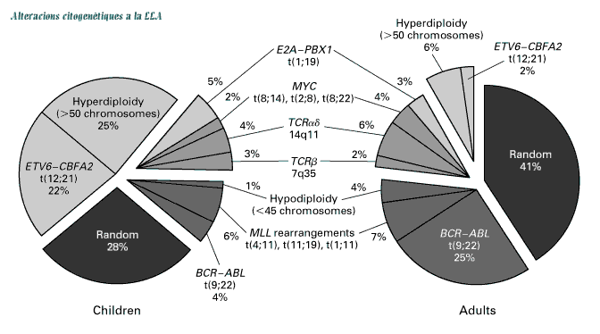
Frecuencia de la leucemia de Burkitt
Pui C-H. NEJM 1998

Slide 3
Clasificación OMS
Frecuencia de los distintos subtipos de LNH
LZM
MALT
LCM
6
2
8
N = 1403
LF
22
LDCG
34
6
LLP
11
Otros
LACG
2
1
7
2
LB
LCTP
LL
Blood 1997;89:3909-3918

Slide 4
HIV-related lymphomas
Non Hodgkin’s
  Diffuse large B-cell (40-60%)
  Burkitt’s or Burkitt-like (20-40%)
  Primary effusion(<5%)
  Plasmablastic(<5%)
Hodgkin’s lymphoma
Notes:
4

Slide 5
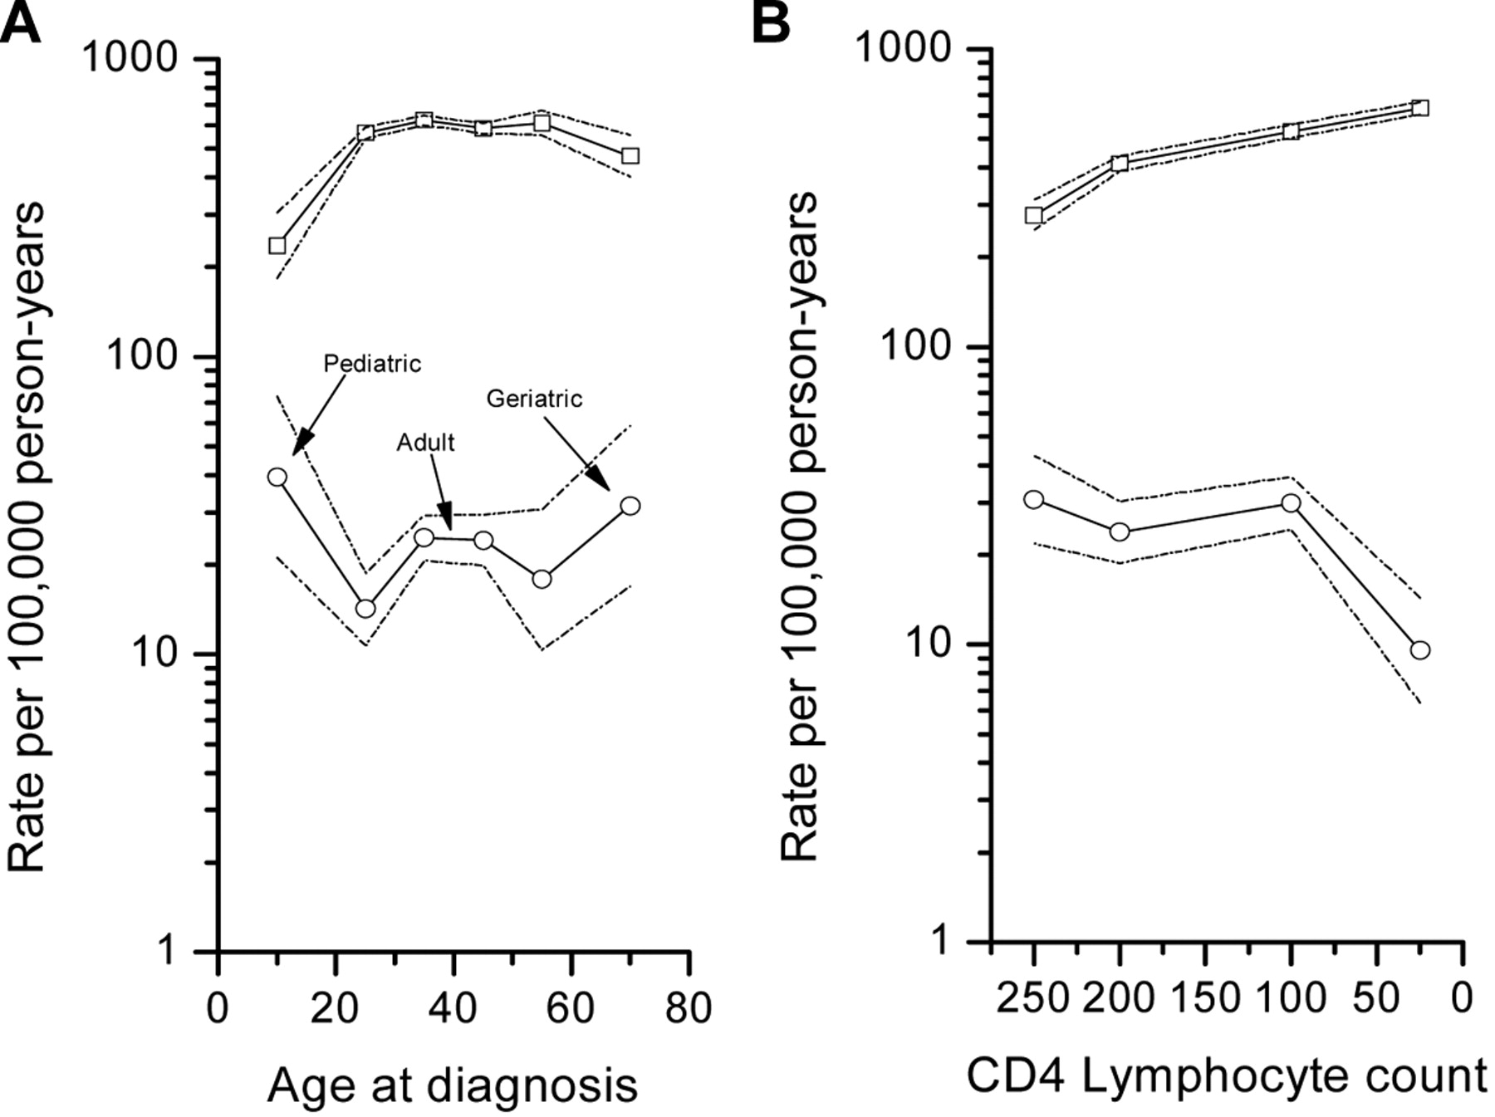
Log incidence rates for BL (○) and for other NHL (□).
Guech-Ongey M et al. Blood 2010;116:5600-5604
Notes:
Log incidence rates for Burkitt lymphoma (○) and for other non-Hodgkin lymphomas (other NHLs), excluding Burkitt lymphoma, (□). (A) By age group (0-19, 20-31, 32-39, 40-51, 52-59, and ≥ 60 years). (B) By 4 CD4 lymphocyte count groups (0-49, 50-149, 150-249, and ≥ 250 cells/μL). Dotted lines show the upper and lower 95% CI.

Slide 6
Leucemia/linfoma de Burkitt
Clínica
Diagnóstico
  Morfologia
  Citofluorometria/inmunohistoquímica
  Citogenética convencional/FISH
  Genética molecular
Diagnóstico diferencial
Tratamiento
  Quimioterapia específica
  Inmunoquimioterapia específica
  Nuevos agentes

Slide 7
Presentación clínica
  Afectación de médula ósea y sangre periférica.
    Leucemia (>20% MO): 25% de casos.
    MO infiltrada <20%: 38% de casos.
  Afección del sistema nervioso central.
    LCR infiltrado 15% (por morfología).
  Masas voluminosas
    Abdominales (intestino, riñón, ovario,…) > 80%

Slide 8
Baseline characteristics
 |  | HIV–positive (n=41 ) | HIV-negative (n=80) | Total (n=121) | p value
Gender, male (%) |  | 34 (83%) | 55 (69%) | 89 (74%) | 0.128
Age, median [min;max] |  | 42 [20 ; 59] | 48 [15 ; 83] | 45 [15; 83] | 0.033
Diagnosis, n (%) | Burkitts Lymphoma | 33 (80%) | 51 (64%) | 84 (69%) | 0.120
 | Burkitt’s leukemia | 4 (10%) | 20 (25%) | 24 (20%)
 | Burkitt-Like Lymphoma | 4 (10%) | 9 (11%) | 13 (11%)
Ann Arbor stage, n (%) | I – II | 6 (15%) | 21 (26%) | 24 (20%) | 0.172
 | III - IV | 35 (85%) | 59 (74%) | 97 (80%)
ECOG ≥2 |  | 22 (54%) | 32/78 (41%) | 54/119 (45%) | 0.245
Extranodal involvement (≥2 sites), n(%) |  | 19 (46%) | 37 (46%) | 56 (46%) | 0.99
CNS involvement, n(%) |  | 4 (10%) | 10 (13%) | 14 (12%) | 0.77
Bulky disease, n(%) |  | 13 (32%) | 15 (19%) | 28 (23%) | 0.118
Elevated LDH, n(%) |  | 40 (98%) | 68/78 (87%) | 108/119 (91%) | 0.095
Age-adjusted IPI, n (%) | Low | 1 (2%) | 6/77 (8%) | 6/118 (5%) | 0.179
 | Low-Intermediate | 4 (10%) | 12/77 (16%) | 17/118 (14%)
 | Intermediate-High | 15 (37%) | 35/77 (45%) | 48/118 (41%)
 | High | 21 (51%) | 24/77 (31%) | 47/118 (40%)
Years of follow-up, median [min;max] |  | 3.2 (1.7) | 2.4 (1.9) | 2.2 (1.9) | 0.09

Slide 9
Leucemia/linfoma de Burkitt
Clínica
Diagnóstico
  Morfología
  Citofluorometria/inmunohistoquímica
  Citogenética convencional/FISH
  Genética molecular
Diagnóstico diferencial
Tratamiento
  Quimioterapia específica
  Inmunoquimioterapia específica
  Nuevos agentes

Slide 10
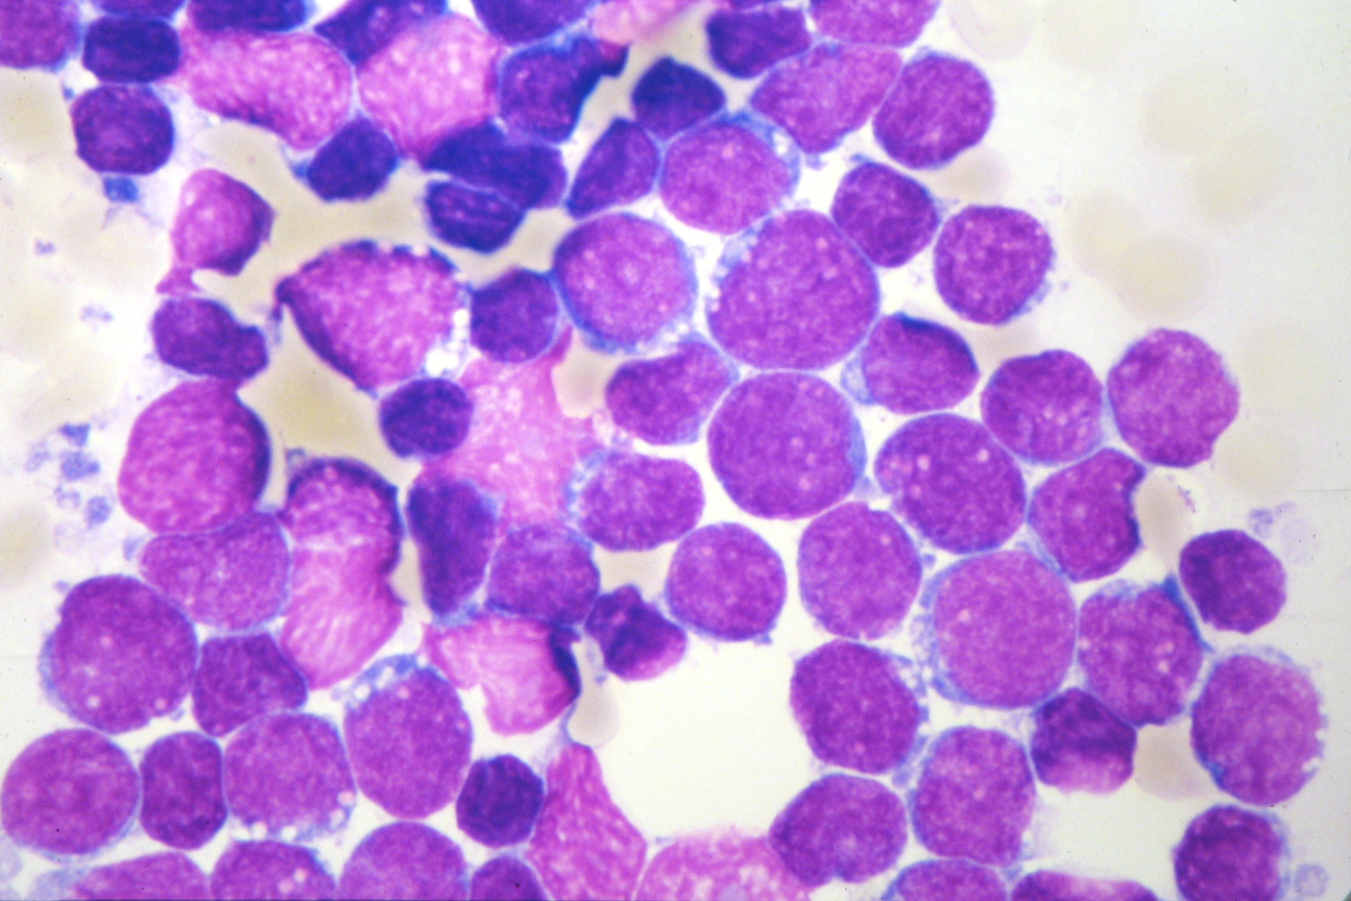
LAL3

Slide 11
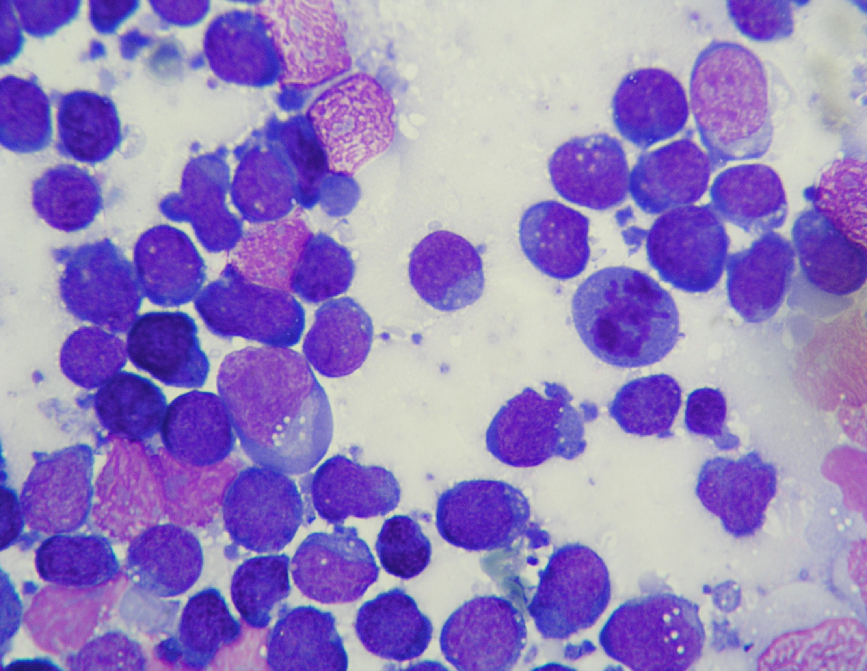

Slide 12
